Slide 1
Citi Bike Trip Histories Analysis (NYC)
Mingliang Zhou
Stony Brook University
Data Incubator Mini-Project
Oct. 23th 2018
GitHub

Slide 2
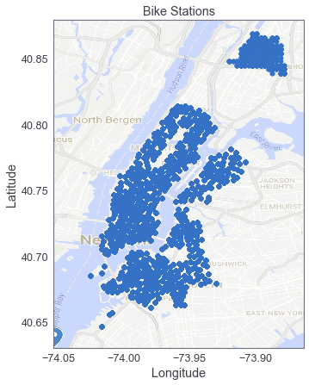
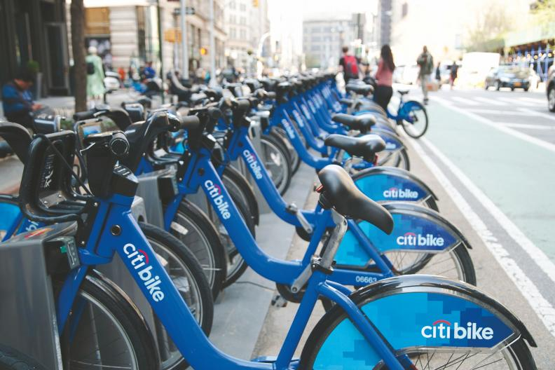
Motivation and Data
Shared bikes getting popular, especially in big cities like NYC;
Citi Bike published trip histories data in NYC;
Questions:
Where, when, how far do people bike?
Promotions for certain people?
Relocation of the bikes?

Slide 3
Day and Subscription
More local users (subscribers) than visitors (customer);
Locals bike more on weekdays, visitors bike more on weekends;
Discount for visitors weekend usage? Locals left or didn’t care.

Slide 4
Trip duration
On average, users bike 10-15 mins per trip;
Visitors bike longer than locals: sightseeing;
Both groups bikes slightly more on weekends: exercise.

Slide 5
Age
Average user age is 35;
Age and day are weakly correlated;
No promotions based on age.

Slide 6
Borrow and return within each day
Borrow and return are imbalanced;
Most users bike during rush hours;
More detailed studies needed.

Slide 7
Bike availability: weekday v.s. weekend
Leave home
Leave
work
Lunch
Arrive
work
Arrive
home
Confirmed: two rush hours are the major challenges;
5 imbalance time period explained;
Relocation after rush hour? Location study needed.

Slide 8
Bike rent: location and time
Rent heavily depends on time. How about imbalance at each station?

Slide 9
Bike availability: location
Imbalance highly depends on locations. How about time?

Slide 10
Imbalance at each station
In the morning, users move from midtown to downtown;
In the afternoon, users move from downtown to midtown;
It seems relocation is not needed: majority are locals;
Field trip is still necessary.

Slide 11
Conclusions
Most CitiBike users are locals: promotions not appeal to them;
More bike uses in weekdays, especially during rush hours;
Visitors bike significantly longer than locals;
Bike availability heavily depends on time and location;
Relocation is not needed if no station dried out in the morning;
More data would be helpful:
Station cost and maintenance fees in different locations: help to optimize the bike locations;
More visitors’ information: primary target for promotions, increase the bike usage over weekends.

Slide 12
Back up

Slide 13
Age anomaly
Most visitors refused to report report their age;
May not matter since age is not a confounding variable.

